Slide 1
Parallelism on Heat 3D Algorithm using OpenMP in C
Aadit - Animesh - Daidipya - Devansh - Drishti

Slide 2




Heat Conduction in 3D
Heat Diffusion Basics
The heat equation models the spread of heat in a 3D object over time:
T(x,y,z,t) : Temperature at a point at a time t
: Thermal diffusivity of a material
Heat flows from hotter regions to cooler regions, leading to a more uniform temperature distribution.
Discretization (Finite Difference Method):
The 3D space is divided into a 3D grid of points represented by coordinates (x,y,z) to calculate the temperature at each point. This process is known as discretization.
Approximating the Derivatives:
We use the following finite difference approximation to approximate the derivatives.
are the temperatures at neighboring grid points along the x-axis.
is the distance between neighbouring points.
Use similar expressions for y and z axis as well.
Time Stepping (Forward Euler Method):
Uses small time steps Δt to update the temperature.

Slide 3
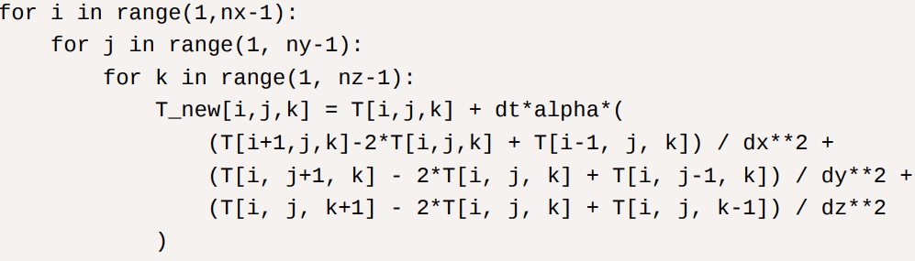
Heat Conduction in 3D
Boundary Conditions:
Boundary conditions affect how heat flows at the edges of the object. These include:
Dirichlet boundary condition: Specifying a fixed temperature at the boundaries.
Neumann boundary condition: Specifying that there is no heat flow across the boundaries (insulated boundaries).
Visualisation:
It helps in understanding how heat diffuses over time. We can use color maps or 3D plots to display
temperature distributions using tools like python and matplotlib.
Here's a code snippet that illustrates the iteration process over the x, y, z coordinates in a 3D grid for
the heat diffusion algorithm:

Slide 4
Using OpenMP
What is OpenMP?
OpenMP (Open Multi-Processing) is a library for parallel programming in C, C++, and Fortran, used for running tasks simultaneously on shared-memory systems. It enables parallelization with minimal changes to the original code..
Why use OpenMP?
Allows parallel execution on multiple cores, speeding up computation compared to sequential processing.
Ideal for large 3D grids, as OpenMP can update multiple cells simultaneously, significantly enhancing
performance.
Key concepts involved:
Directives: Commands like #pragma in C/C++ that specify regions of code to be parallelized.
Parallel Regions: Code blocks executed by multiple threads using #pragma omp parallel.
DOALL Parallelism: Suitable for independent iterations such as grid updates (#pragma omp for), allowing
each grid cell's temperature calculation to run in parallel.
Data Sharing: Variables like grid data can be set as shared to be accessible by all threads.

Slide 5
DOALL Parallelism

Slide 6
What is DOALL Parallelisation
DOALL is a type of loop-level parallelism where every iteration of a loop is independent of the others, meaning they can all be executed in parallel without needing to wait for each other. This is ideal for algorithms where operations on each element in a data set can be performed independently.
In the 3D heat diffusion algorithm: Each point in the grid at a given time step can be updated based on the temperatures of its neighboring points.
The computation for each grid cell at a time step is independent of the updates to other cells because it relies only on the values from the previous time step.
This independence makes the algorithm suitable for DOALL parallelism, as each grid points temperature can be updated concurrently with others.

Slide 7
Advantages of DOALL Parallelism
Increased Throughput : By allowing each CPU core to process different cells simultaneously, we reduce overall computation time significantly.
Scalability : As the grid size grows, more threads can be added to handle additional cells, making DOALL highly scalable on multi-core systems.
Minimal Synchronization : Since each iteration is independent, there's no need for synchronization between threads within a single time step. Only after completing a full time step, the updated values are shared.

Slide 8
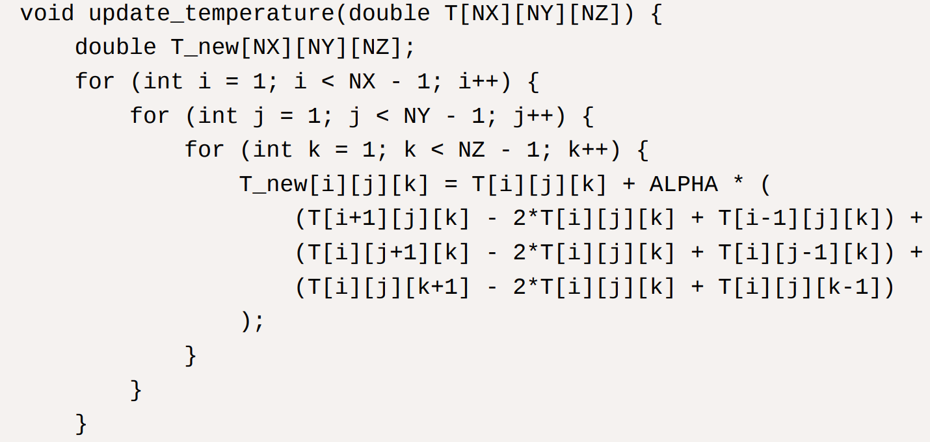
Sequential Implementation
This is the code snippet for the sequential implementation of of the Heat 3D Algorithm as we saw before.

Slide 9
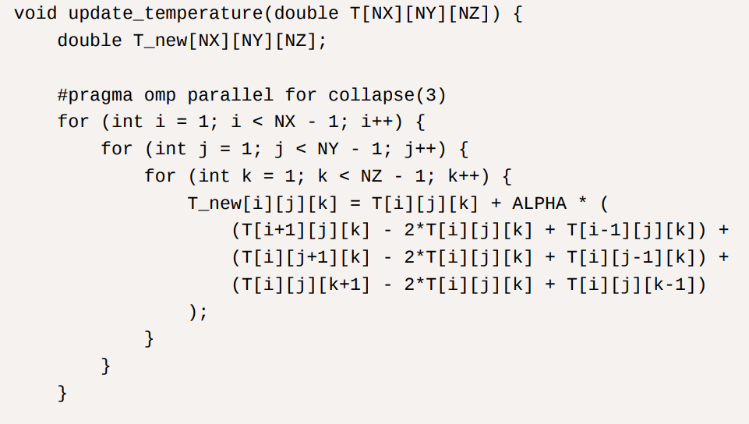
Implementation using DOALL parallelism
This is a C program implementing the 3D Heat Diffusion algorithm using OpenMP with DOALL parallelism to process each point in the grid in parallel. To enable parallelism, well add OpenMP #pragma omp parallel for to update each cell in parallel. This allows each core to update a part of the grid at the same time

Slide 10
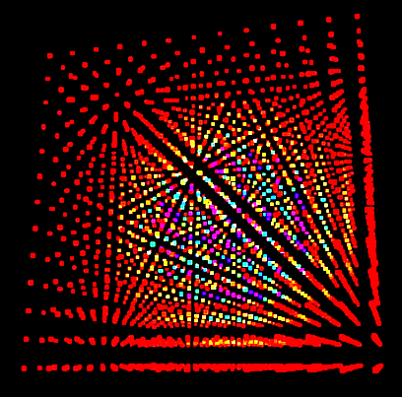
Visualizing Heat Flow

Slide 11
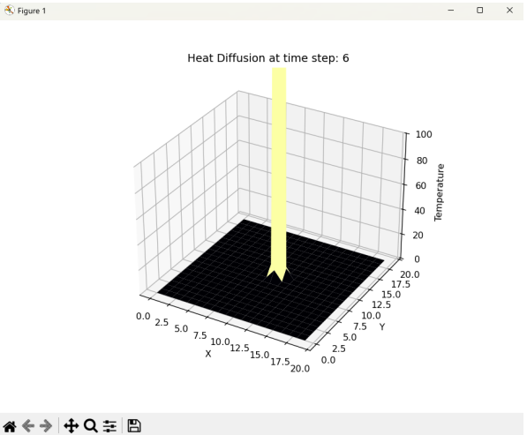
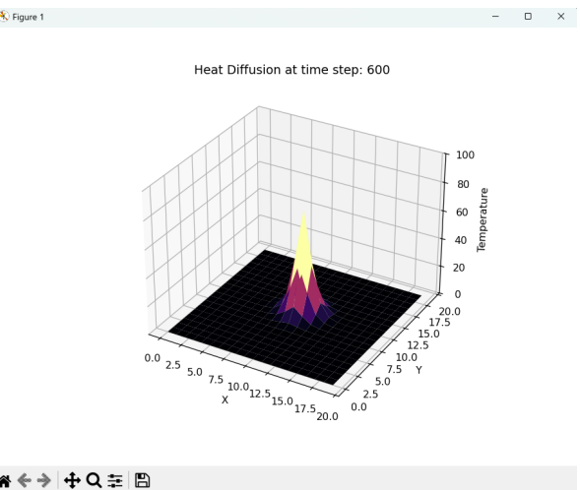
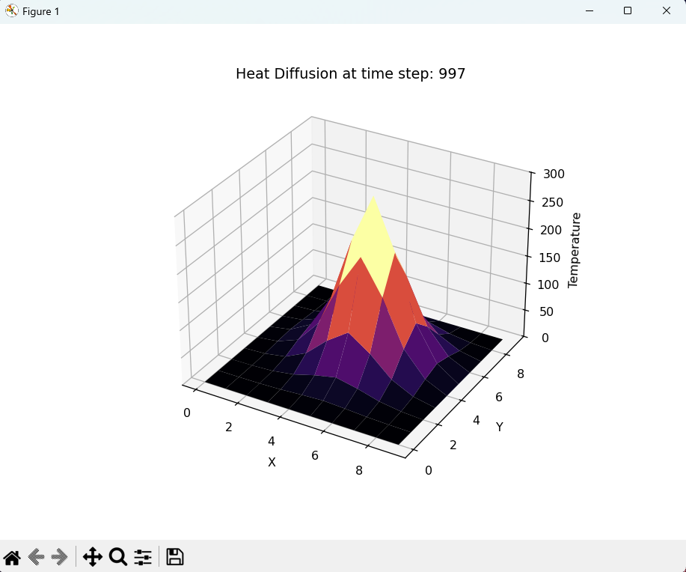
Visualisation of Heat Flow

Slide 12

Visualizer Video

Slide 13
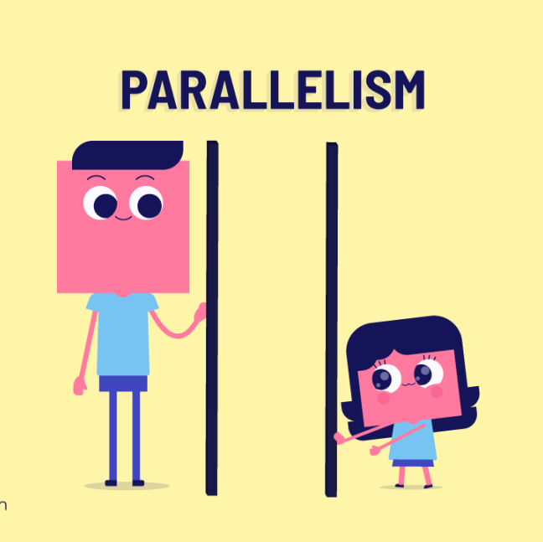
Other Types of Parallelism

Slide 14
Tiling Cache Parallelism
Splits large computations into smaller, manageable tiles that fit into the CPU cache for improved processing efficiency.
Reduces access time by utilizing the CPU cache, minimizing the slower access to main memory.
Enhances performance by exploiting spatial and temporal locality during computation.
Tiles are designed to keep necessary data in the cache during computation, avoiding frequent cache misses.
Uses ghost cells as placeholders for neighboring tile data, ensuring smooth processing across boundaries.
Can be paired with DOALL parallelism (independent parallel computation) within each tile for further speedup.
Optimized computation with reduced memory latency, better resource utilization, and faster execution times.

Slide 15
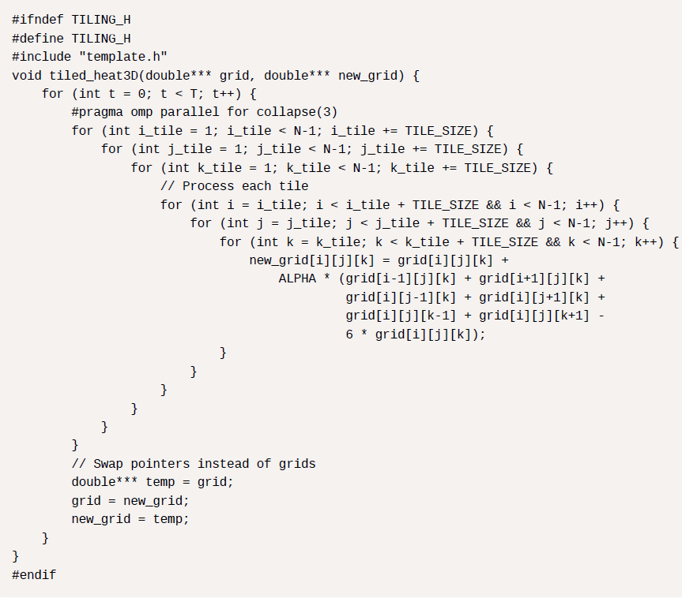
Tiling Cache Parallelism
This is the code snippet for Tiling Cache Parallelism implementation of the Heat 3D Algorithm.

Slide 16
Wavefront Parallelism
A technique for problems with calculation dependencies propagating in a wave-like direction.
Processes in the wavefront (ripple) are independent and can be calculated in parallel, improving execution time.
Dependencies exist only with time, not within the same time step.
Wavefront computation doesn’t align directly with dependencies, requiring global synchronization for each step.
Assume the wave propagates along the body diagonal of the grid in one time step.
Diagonal planar slices of the cubic grid become the wavefront.
Each diagonal slice (wavefront) can be computed independently in parallel.
While less efficient than ideal cases, this approach leverages parallelism effectively for significant time savings.
Accelerates computations by dividing the work across diagonal planes while respecting dependencies.

Slide 17
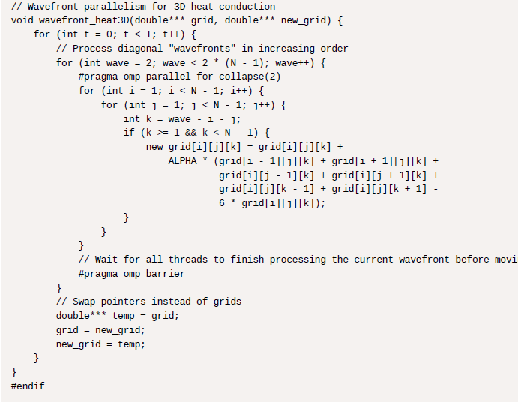
Wavefront Parallelism
This is the code snippet for Wavefront Parallelism implementation of the Heat 3D Algorithm.

Slide 18
NUMA Parallelism
A technique that optimizes for Non-Uniform Memory Access (NUMA) architecture, where memory access speed depends on proximity to the CPU.
Local memory (on the same node as the CPU) is faster to access than remote memory (on a different node).
Structure programs so CPUs primarily access local memory, reducing latency and improving performance.
Divide the 3D grid into subdomains aligned with NUMA nodes.
Assign subdomains to specific CPUs or thread groups within each NUMA node.
Allocate subdomain data in local memory to minimize cross-node traffic.
Bind threads to CPUs within the same NUMA node to preserve data locality.
Use ghost cells for subdomain boundaries, periodically updating them to handle cross-node dependencies while reducing remote memory access.

Slide 19
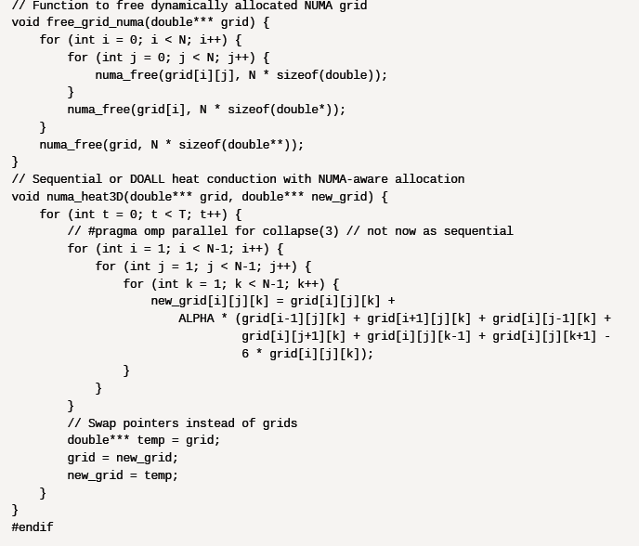
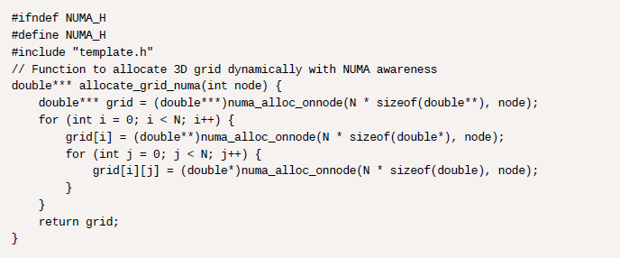
NUMA Parallelism
This is the code snippet for NUMA Parallelism implementation of the Heat 3D Algorithm.

Slide 20
Domain Decomposition Parallelism
A parallelization technique that divides a large computational domain into smaller, manageable subdomains for parallel processing.
Each subdomain is assigned to different processors or threads and processed independently, improving performance.
Divide the 3D grid into sub-grids to enable parallel computation.
Update boundary cells of sub-grids to ensure continuity and avoid errors.
Synchronize sub-grid computations to maintain continuity across the entire domain.
Employ ghost cells at sub-grid boundaries to simplify handling dependencies.
Periodically synchronize ghost cells to represent data from neighboring sub-grids.
Ensures accurate, efficient, and scalable computation for large scientific problems.

Slide 21
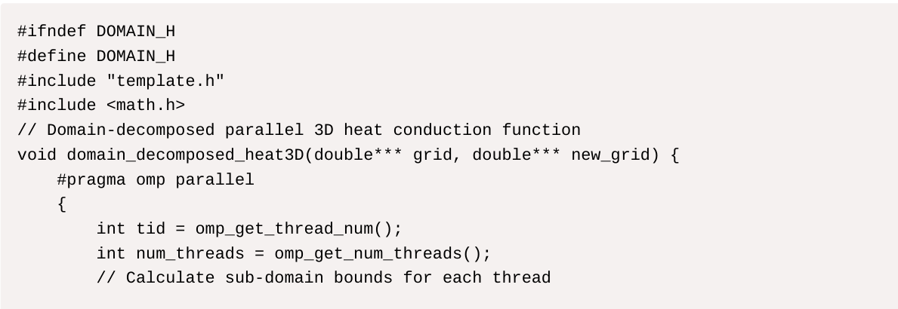
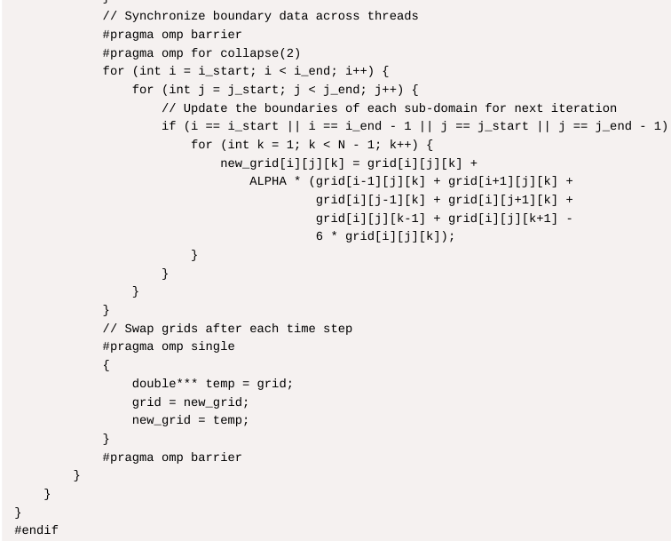
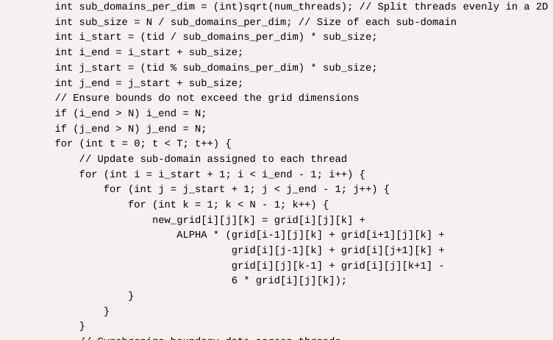
Domain Decomposition Parallelism
This is the code snippet for Domain Decomposition Parallelism implementation of the Heat 3D Algorithm.

Slide 22
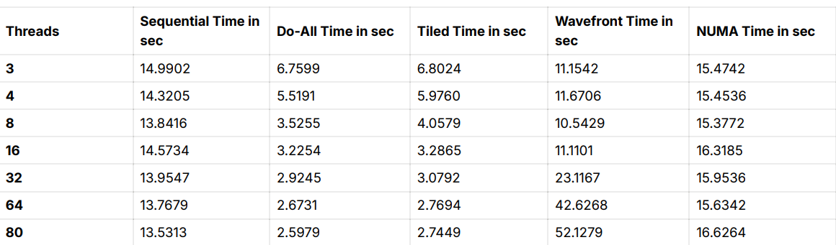
PLOTS AND DATA
All Data after running program under various cases:
Initial parameters:
N = 100 (Grid Size)
T = 1000 (Initial Temperature)
Alpha = 0.01
Tile size = 4
Temp Source = 1000.0

Slide 23
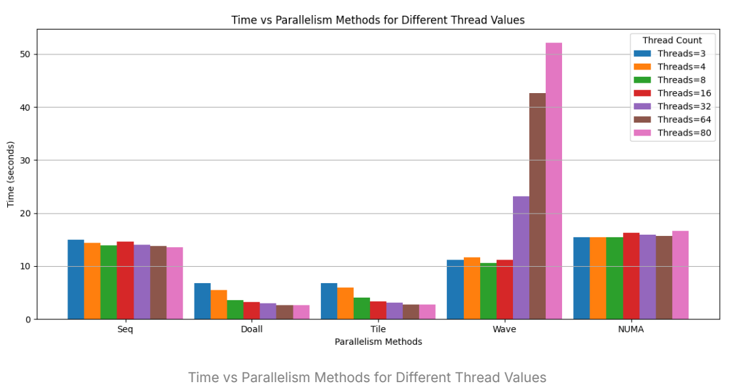
PLOTS AND DATA

Slide 24
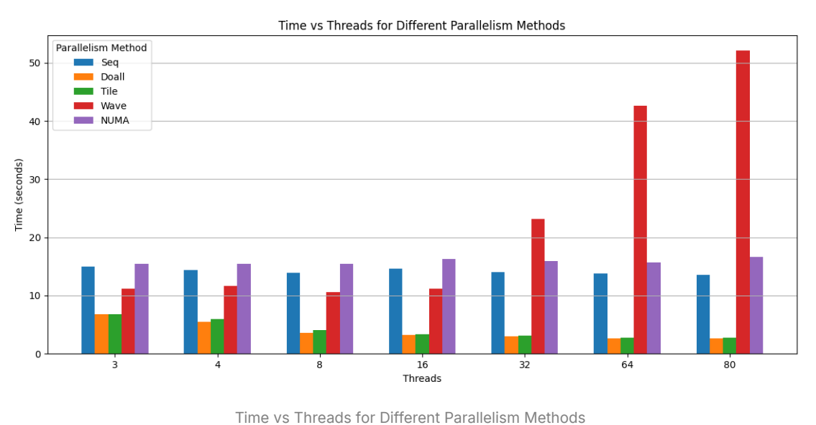
PLOTS AND DATA

Slide 25
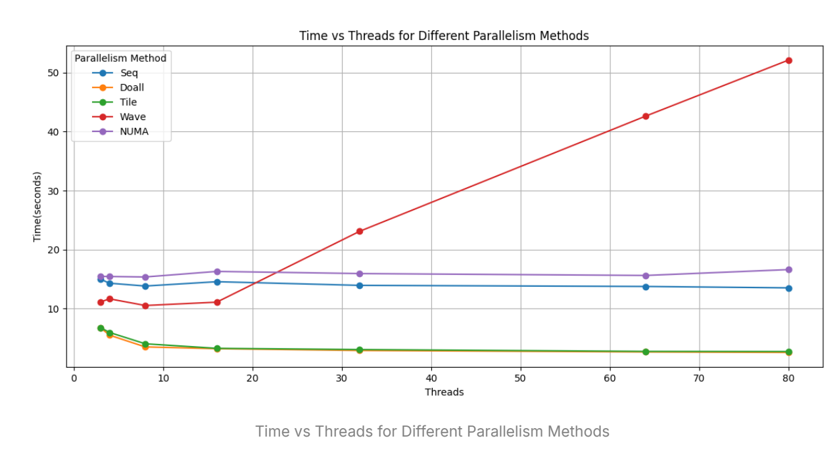
PLOTS AND DATA

Slide 26
References
https://www.openmp.org/wp-content/uploads/openmp-examples-5.2.2-final.pdf OpenMP and Parallelism Methods and Code Help)
https://www.sciencedirect.com/science/article/pii/S0955799717306604
(More about Heat3D algorithm and visualization)

